Slide 1


Electric Circuits
Twelfth Edition, Global Edition
Chapter 3 – Part 1
Simple Resistive Circuits
© 2024 Pearson Education Ltd. All Rights Reserved.
Notes:
If this PowerPoint presentation contains mathematical equations, you may need to check that your computer has the following installed:
1) Math Type Plugin
2) Math Player (free versions available)
3) NVDA Reader (free versions available)

Slide 2
Chapter 3 – Simple resistive circuits (1 of 20)
Objectives:
3.1 Know how to identify components connected in series and in parallel
3.2 Be able to find the equivalent resistance of series-connected and parallel-connected resistors
3.3 Be able to recognize circuits where voltage division occurs and know how to use voltage division to analyze such circuits
3.4 Be able to recognize circuits where current division occurs and know how to use current division to analyze such circuits

Slide 3
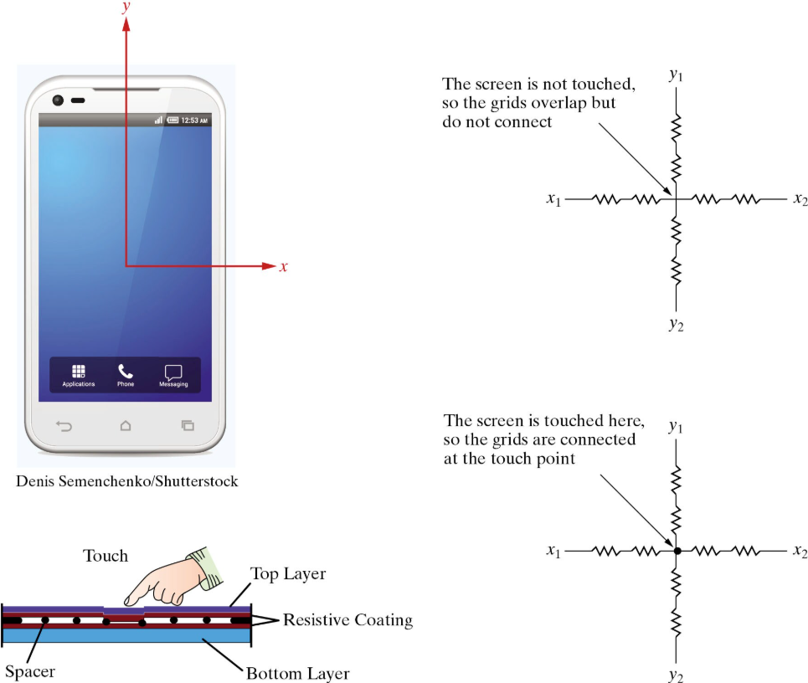

Slide 4
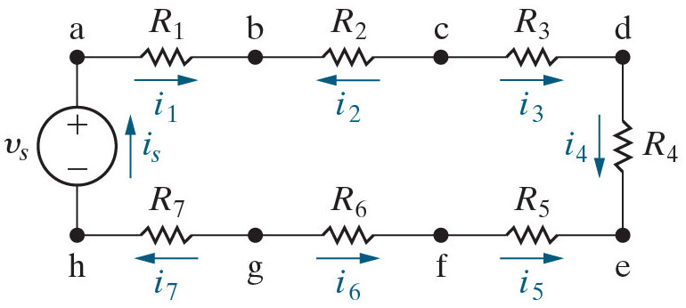
Chapter 3 – Simple resistive circuits (2 of 20)
Resistors in series:
Connected end-to-end
Have the same current (because of K C L)

Slide 5
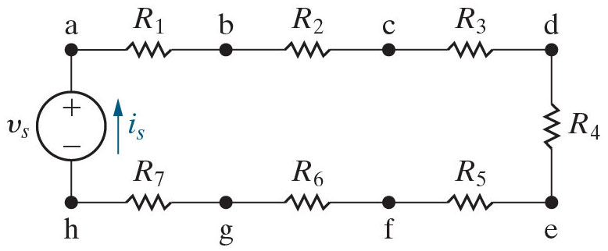
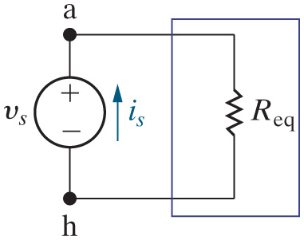
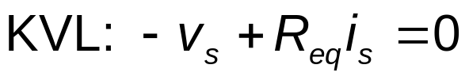


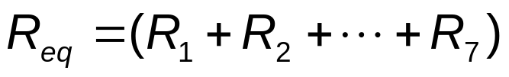
Chapter 3 – Simple resistive circuits (3 of 20)
Resistors in series:
Find the equivalent resistance
Resistors in series add:
Equivalent resistance is always larger than the largest resistance in the group.

Slide 6
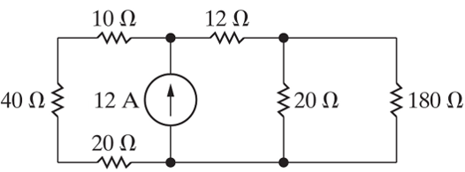





Chapter 3 – Simple resistive circuits (4 of 20)
Which of the resistors in the circuit below are connected in series?
A.
and
B.
and
C.
and
and
D.
and

Slide 7


Chapter 3 – Simple resistive circuits (4 of 20)
Which of the resistors in the circuit below are connected in series?
A.
and
B.
and
C.
and
and
D.
and

Slide 8




Chapter 3 – Simple resistive circuits (5 of 20)
Find the equivalent resistance of the series-connected resistors in the circuit here

Slide 9
Chapter 3 – Simple resistive circuits (5 of 20)
Find the equivalent resistance of the series-connected resistors in the circuit here

Slide 10
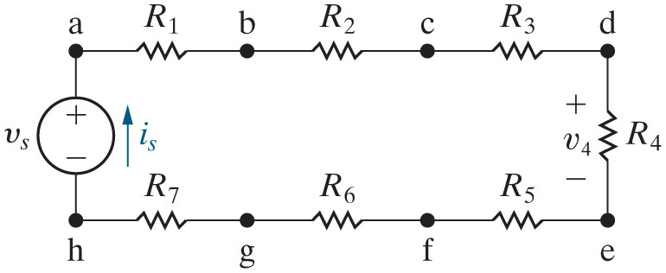
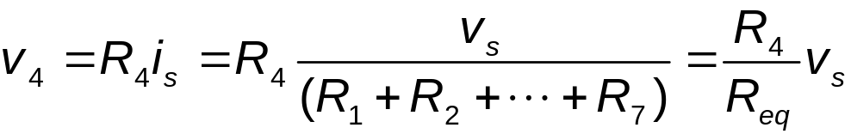
Chapter 3 – Simple resistive circuits (6 of 20)
Voltage division:
Find the voltage drop across one of a group of series-connected resistors
Notes:
Long Description:
v subscript 4 Baseline equals R subscript 4 Baseline i subscript s Baseline equals R subscript 4 Baseline Start Fraction v subscript s over Open Parenthesis R subscript 1 Baseline plus R subscript 2 Baseline plus upto plus R subscript 7 Close Parenthesis End Fraction equals Start Fraction R subscript 4 Baseline over R subscript e q Baseline End Fraction v subscript s Baseline.

Slide 11
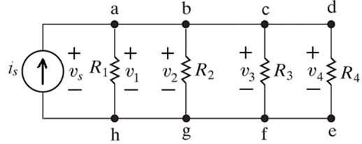
Chapter 3 – Simple resistive circuits (8 of 20)
Resistors in parallel:
Connected at both ends
Have the same voltage (because of K V L)

Slide 12
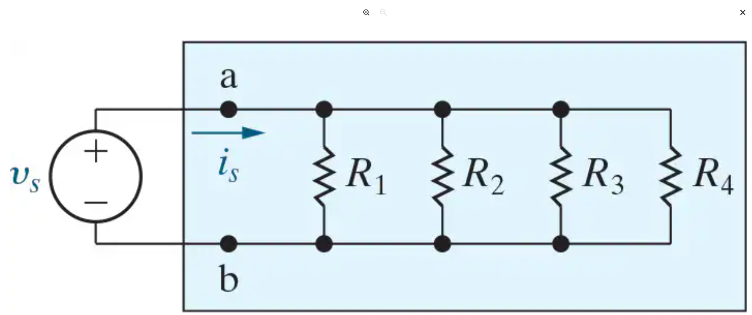





Slide 13


Slide 14
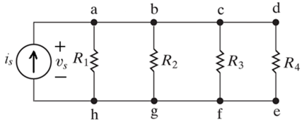
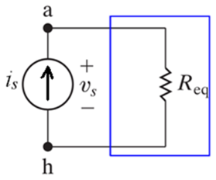




Chapter 3 – Simple resistive circuits (9 of 20)
Resistors in parallel:
Find the equivalent resistance
Resistors in parallel:
Equivalent resistance is always smaller than the smallest resistance in the group.

Slide 15
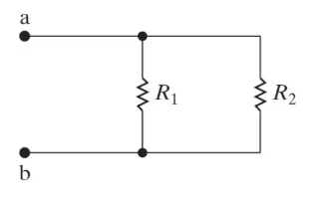
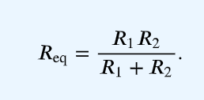
Chapter 3 – Simple resistive circuits

Slide 16
Chapter 3 – Simple resistive circuits (10 of 20)
Which of the resistors in the circuit below are connected in parallel?
and
and
and
and
and

Slide 17
Chapter 3 – Simple resistive circuits (10 of 20)
Which of the resistors in the circuit below are connected in parallel?
and
and
and
and
and

Slide 18

Chapter 3 – Simple resistive circuits (11 of 20)
Find the equivalent resistance of the parallel-connected resistors in the circuit here

Slide 19
Chapter 3 – Simple resistive circuits (11 of 20)
Find the equivalent resistance of the parallel-connected resistors in the circuit here

Slide 20
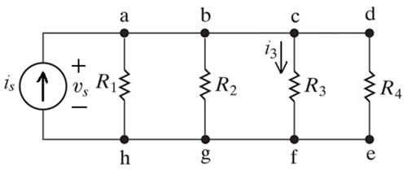
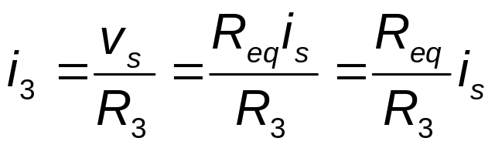
Chapter 3 – Simple resistive circuits (12 of 20)
Current division:
Find the current through one of a group of parallel-connected resistors
Notes:
Long Description:
i subscript 3 Baseline equals Start Fraction v subscript s Baseline over R subscript 3 Baseline End Fraction equals Start Fraction R subscript e q Baseline i subscript s Baseline over R subscript 3 Baseline End Fraction equals Start Fraction R subscript e q Baseline over R subscript 3 Baseline End Fraction i subscript s.

Slide 21
Chapter 3 – Simple resistive circuits (14 of 20)
Duality
Voltage sources | Current sources
Resistance | Conductance
K V L | K C L
Series connection | Parallel connection
Voltage division | Current division
Short circuit | Open circuit
The image shows a horizontal ellipsis. | The image shows a horizontal ellipsis.

Slide 22
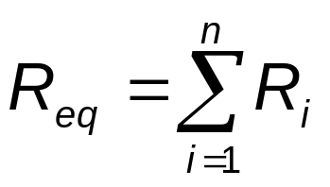
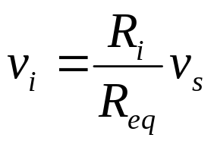
Chapter 3 – Simple resistive circuits (15 of 20)
Review:
Series-connected components
Resistors in series add
Voltage division allows you to find the voltage across one component when you know the voltage across a collection of series-connected components:

Slide 23
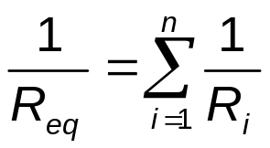
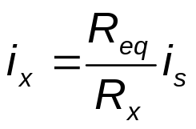
Chapter 3 – Simple resistive circuits (16 of 20)
Review:
Parallel-connected components
Add the inverse resistance of resistors in parallel to get the inverse of the equivalent resistance
Current division allows you to find the current through one component when you know the current supplied to a collection of parallel-connected components:

Slide 24

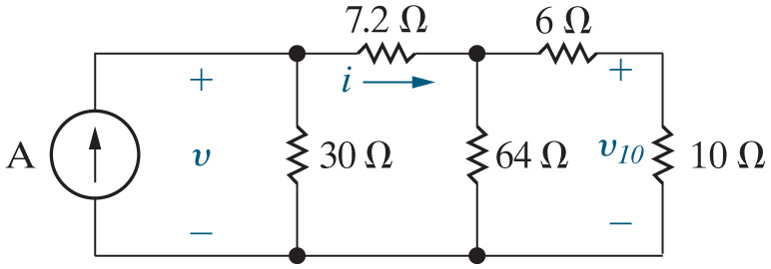
Chapter 3 – Simple resistive circuits (17 of 20)
Example: Find v, i, and
by combining resistors in series
and parallel, voltage division, and current division.

Slide 25




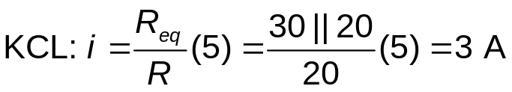
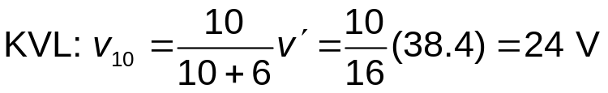
Chapter 3 – Simple resistive circuits (17 of 20)
Example: Find v, i, and
by combining resistors in series
and parallel, voltage division, and current division.
Find the equivalent resistance:

Slide 26
Chapter 3 – Simple resistive circuits (17 of 20)
Example: Find v, i, and
by combining resistors in series
and parallel, voltage division, and current division. The current source operates at 5 A.
Find the equivalent resistance:

Slide 27

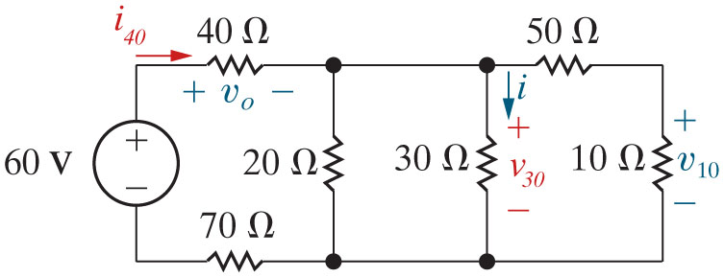
Chapter 3 – Simple resistive circuits (20 of 20)
Example: Find v, i, and
using series and parallel simplification, and
voltage and current division.

Slide 28






Chapter 3 – Simple resistive circuits (20 of 20)
Example: Find v, i, and
using series and parallel simplification, and
voltage and current division.

Slide 29
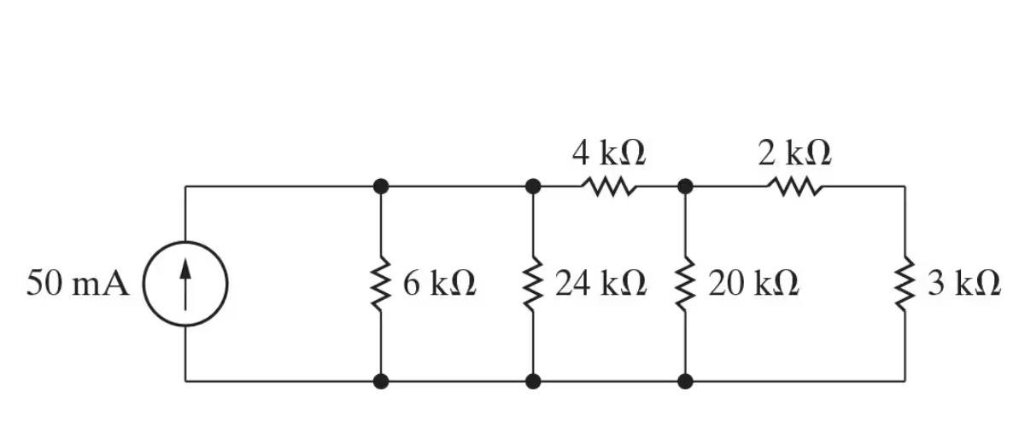
Chapter 3 – Simple resistive circuits
Find the equivalent resistance seen by the current source
Find the power delivered by the current source

Slide 30
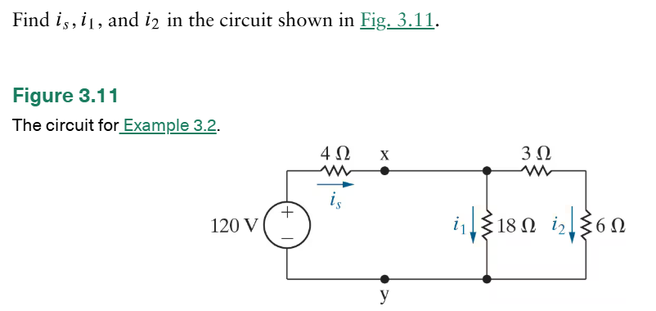
Chapter 3 – Simple resistive circuits

Slide 31
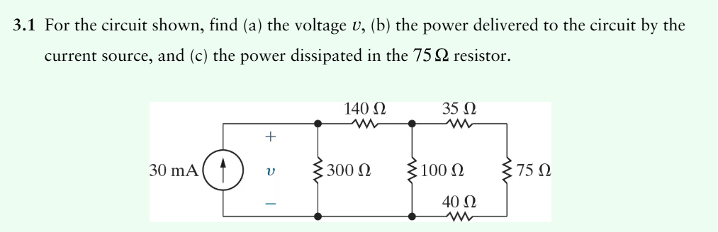
Chapter 3 – Simple resistive circuits

Slide 32
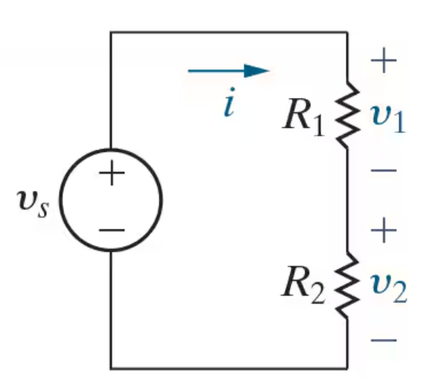
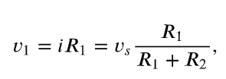
Chapter 3 – Simple resistive circuits

Slide 33
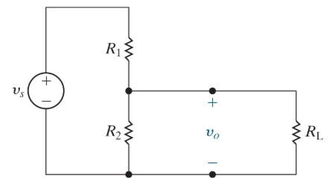
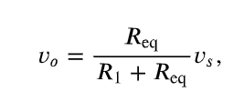
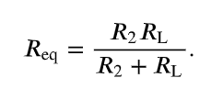
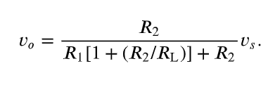
Chapter 3 – Simple resistive circuits

Slide 34
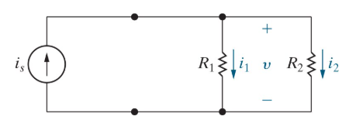
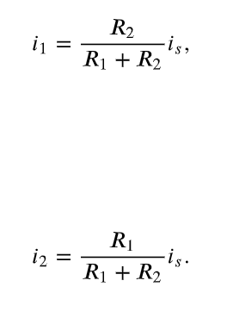
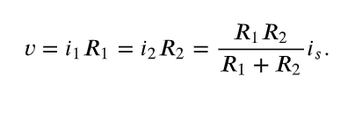
Chapter 3 – Simple resistive circuits

Slide 35
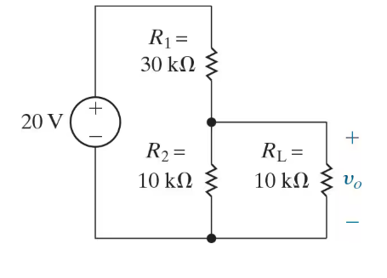
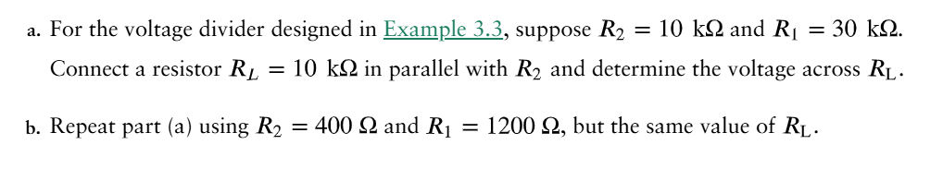
Chapter 3 – Simple resistive circuits

Slide 36
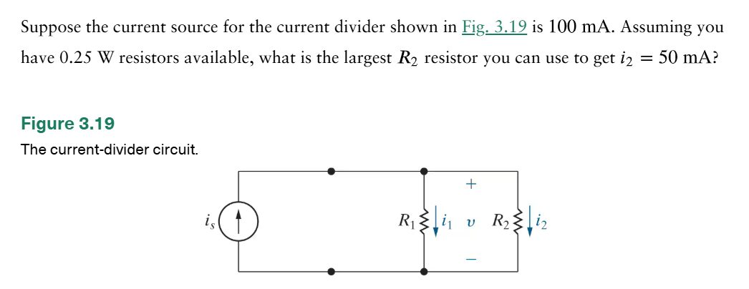
Chapter 3 – Simple resistive circuits

Slide 37
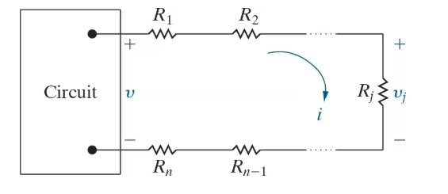
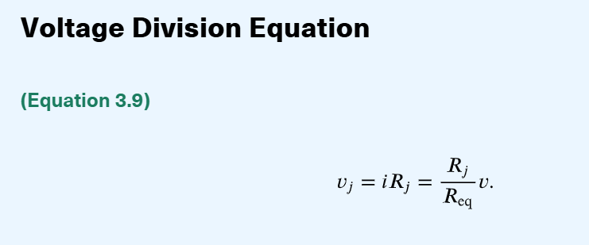
Chapter 3 – Simple resistive circuits

Slide 38
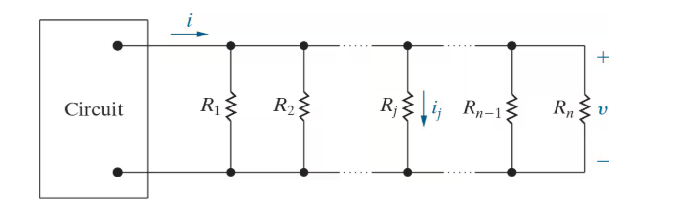
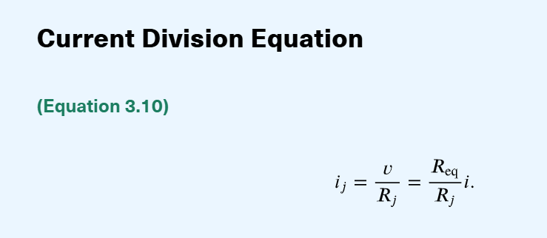
Chapter 3 – Simple resistive circuits

Slide 39
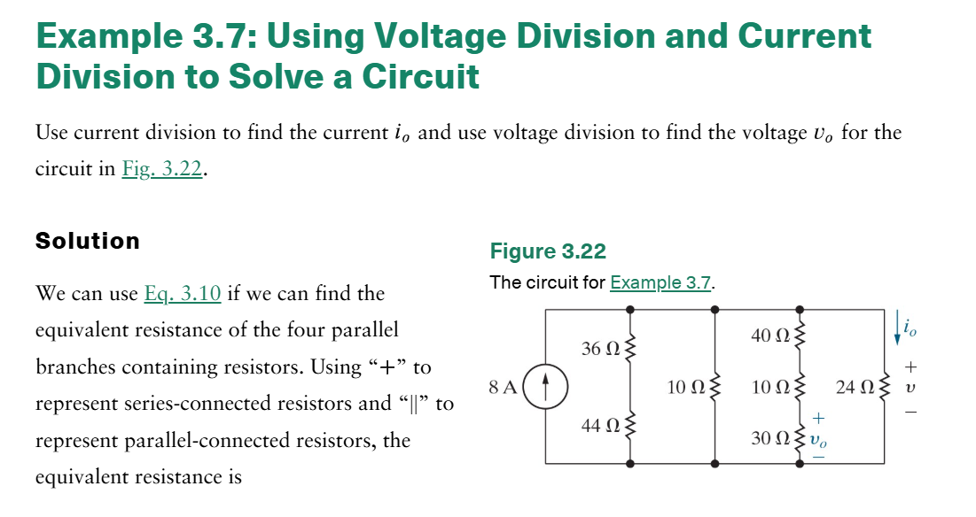
Chapter 3 – Simple resistive circuits

Slide 40
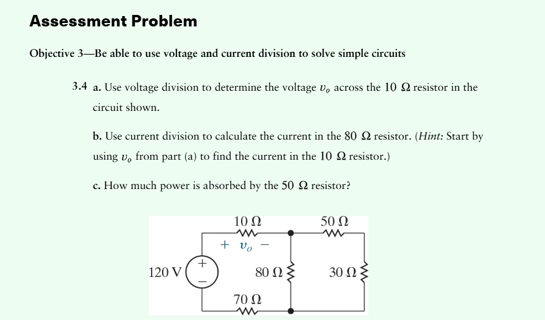
Chapter 3 – Simple resistive circuits

